Slide 1
Rainbow Health Ontario 2014 Conference
Creating Change Together in Two-Spirit Research: An Example from the Two-Spirit HIV/AIDS Wellness and Longevity Study (2-SHAWLS)
Tony Nobis¹, Art Zoccole¹, David Brennan², Randy Jackson³, and George Georgievski²
¹2-Spirited People of the First Nation, ²University of Toronto,³McMaster University
Toronto, Ontario
February 6, 2014

Slide 2
Acknowledgements
Catalyst Grant funded by the Canadian Institutes of Health Research (No. 492662)
Research Team
Investigators: David J. Brennan (PI), Art Zoccole (Principle Knowledge User), Randy Jackson (Co-I), and Tony Nobis (Co-I)
Research Staff: Earl Nowgesic (PhD candidate), Chavisa Brett (Research Coordinator), and Georgi Georgievski (Undergraduate Research Assistant)
Advisory Committee
OAHAS—the Ontario Aboriginal HIV/AIDS Strategy— (Doe O’Brien-Teengs, Heather Chierici, Sharp Dopler, and Lyndon George)
Nine Circles Community Health Clinic (Petanacoot Nenakawekapo)
Toronto Aboriginal Care Team (Alita Sauve)
Union of Ontario Indians HIV/AIDS Program (Jodi Cotter)

Slide 3
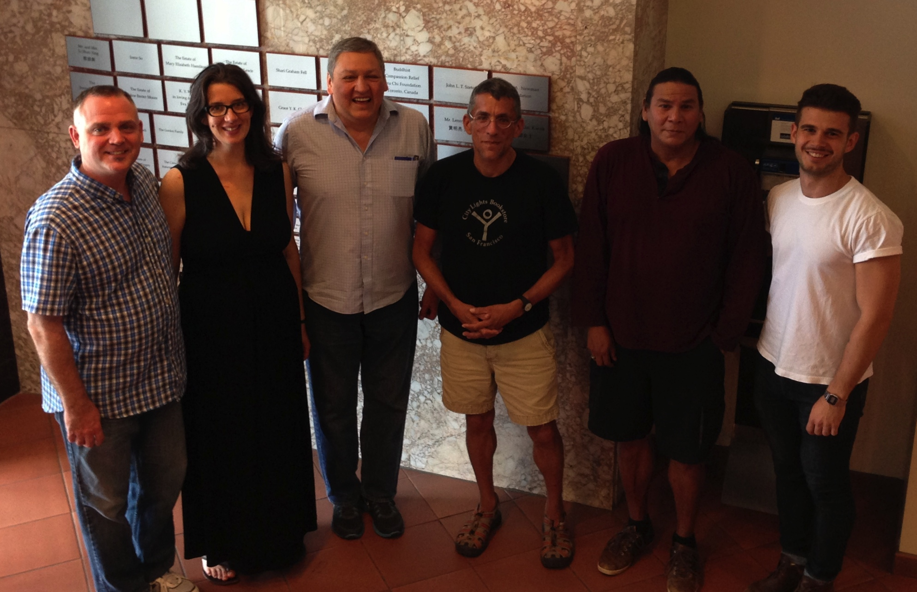
David Brennan, Chavisa Brett, Art Zoccole, Randy Jackson, Tony Nobis, and Georgi Georgeivski. Missing: Earl Nowgesic

Slide 4
Background: HIV/AIDS in Aboriginal Canada (1 of 5)
Aboriginal peoples are over-represented
Aboriginal peoples are “3.8% of the Canadian population … and yet an estimated 4,300 to 6,100 Aboriginal people were living with HIV (including AIDS) in Canada in 2008 (i.e., 8.0% of all prevalent HIV infections)” (PHAC, 2010, p. 2).
Youth
(15-29)
32.6% (Aboriginal)
20.5% (non-Aboriginal)
Women
48.8% (Aboriginal)
20.6% (non-Aboriginal)
Injection Drug Use
66% (Aboriginal)
17% (non-Aboriginal)
(PHAC, 2010)

Slide 5
Background: HIV/AIDS in Aboriginal Canada (2 of 5)
Aboriginal people are more likely to have a later diagnosis compared to non-Aboriginal people (Stokes, Pennock, & Archibald, 2006)
Slower uptake of anti-retroviral treatments (Wood et al, 2006)
Less access to experienced physicians (Miller et al, 2006)
Higher morbidity
Shorter survival times
A mortality rate three times higher than for non-aboriginals (Lima, 2006)
A community-identified concern
How best to deliver services that support resiliency
Intersections of racism, colonization and homophobia represent distinct issues

Slide 6
Background: Focusing on Two-Spirit Men’s Health (3 of 5)
Two-spirit men represent a distinct population
20% of all new HIV infections in 2008 (PHAC, 2010)
Two-spirit men experience a higher portion of injection drug use than non-aboriginal MSM (PHAC, 2011)
72% of all Aboriginal people living with HIV have an AIDS diagnosis
“Leading an Extraordinary Life: Wise Practices for a HIV Prevention Campaign for Two-Spirit Men” (Thoms, 2007)
Barriers identified for suitable HIV prevention programs for two-spirit men
Homophobia
Access to care related to self-worth
Inclusion of relationships two-spirit men have with their families and spiritual connections
Dearth of information about resiliency, strengths, assets of two-spirit men living long-term with HIV/AIDS

Slide 7
Background: Two-Spirit (4 of 5)
Two-spirit refers to men and women who self-identify as possessing both male and female attributes
Masculine/feminine spirit
Live between gendered experiences or roles
Embedded in cultural understanding of roles (e.g., seers, visionaries, healers)
A gender designation / does not refer to sexual orientation

Slide 8
Background: Envisioning Other Possibilities (5 of 5)
Useful but provides only a partial description
Paints an overall picture of suffering and dysfunction (Lavallee & Poole, 2010) among Aboriginal people
Contributes to the construction of Aboriginal identity that shape responses (Bond, 2005; Reading & Nowgesic, 2002)
Need for research that also focuses on thriving health, including wellness for two-spirit men living long-term with HIV
Anecdotal evidence—based on three decades of community work among two-spirit men—documents the ways in which this population is faring well
Literature provides little to no information about resiliency, strengths, assets of two-spirit men living with HIV and ways this can be used to support community efforts

Slide 9
Goal/Objectives
To better understand the factors, skills, resources, knowledge and practices that contribute to two-spirit men’s health and well-being living with HIV
Conduct a comprehensive review of the literature
Conduct a series of focus groups
Further develop community/academic partnerships
Utilize results to develop a larger study focused on strengths, resiliencies and assets of two-spirit men living with HIV

Slide 10
How did we do this?
Literature review
Sharing circles/focus groups

Slide 11
Literature Review
Used Arksey and O’Malley (2007) scoping review process
Refine, clarified and linked goal of review with with research questions
Searched for relevant studies – breadth and comprehensiveness
Selected appropriate studies for inclusion
Charted the data – comparative analysis
Collated and summarized results – using Nvivo – thematic analysis
Stakeholder consultation

Slide 12
Search Terms
Note: The asterisk (*) is a wildcard character allowing for a search of any word with that prefix.
Orientation |  | People |  | Condition |  | Approach
"2-spirit*" "two-spirit*" "two spirit*" LGBT* GLBT* intersex* pansexual* bisexual* gay* homosexual* lesbian* queer* trans transsexual* transgender* omnisexual* genderqueer* "gender queer*" "gender-queer*" MSM "F to M" "M to F" heterosexual* "A-sexual*" "third gender*" "fourth gender*" "double sex*" doublesex* "twin spirit*" twinspirit* | AND | Aboriginal* Aborigine* Indigenous native* "first nation*" "first-nation*" "1st nation*" "1st-nation*" Indian* Amerindian* tribal autochtone* amerindien* Aborigene* indigene* | AND | HIV HIV positive HIV-positive HIV/AIDS HIV and AIDS Living with HIV Living with AIDS Living with HIV/AIDS HIV affected | AND | resilient* resilience* resiliency Coping Cope* "Protective Factor*" "Protective Process*" wellbeing "well-being" "well being" "optimal health" "mental health" strength* wellness

Slide 13
Inclusion Criteria
Does the article include a focus on Aboriginal peoples?
Does the article address two-spirit, gay, bisexual or transgender issues?
Does some component or all of this article address the intersection of living with HIV for more than two years?
Is resilience in its broadest form (wellness, coping, strength) addressed in the article?”

Slide 14
Scoping the Literature
Electronic Databases (n=12)
Proquest | 1,831
Scopus | 2,544
Medline | 1,557
EMBASE | 2,335
CINAHL | 621
Web of Knowledge | 1,850
PsychInfo – Ovid | 2,265
Social Work Abstracts - Ovid | 78
LGBT Life | 753
Bibliography of Native North Americans | 246
Native Health Database | 575
Indigenous Studies Portal | 1,001
Total References | 15,779
Duplicates | 8,627
Excludes (By at least two reviewers) | 7,109
Total Yield Included | 43

Slide 15
Literature Review
Both academic and Aboriginal team members noted difficulty in being able to determine whether or not published research included participatory, decolonizing and/or indigenous methodologies – whether or how ceremony was used in research settings;
Fine-tuning 5 main research questions to include or exclude research articles;
Finding a way to “save” articles of interest excluded from the lit review so as these articles are available for future reference;

Slide 16
Retreat
Mutual learning about western research protocols and requirements, and indigenous knowledge and methods;
Incorporated relevant and significant indigenous spirituality; Development of the team in relation to having a long-term APHA, two-spirit and AIDS friendly Spiritual Helpers on the Advisory Board (CAB);
Advising the Research Team on how Aboriginal cultural protocols can complement western research methodology;

Slide 17
Team Building
Finding suitable Research Advisory Team members who are of Aboriginal descent;
Designing a recruitment strategy and hiring process sensitive to western and Aboriginal requirements;
Balancing western and Aboriginal priorities;
Selection of staff, Aboriginal does not automatically mean suitable, lack of cultural-sensitivity v. being over-apologetic;

Slide 18
Research Ethics
Both Aboriginal and non-Aboriginal team members worked collaboratively preparing for our submission to the REB;
Aboriginal members suggested methods, priorities, cultural practices that work, the academics suggested how such things would be viewed and responded to by the REB;
Freedom to ‘adapt as we go’ was severely curtailed once our plan went before the university Research Ethics Board;
Established protocol eliminated involvement of non-academics in some areas of the research process; setting up sites, direct communication with participants, and recruitment;

Slide 19
Data Collection
Focus group recruitment (role of team members in terms of confidentiality)
Lower numbers based on confidentiality in a group

Slide 20
Developing the Research Tool
Academics sought direction from the Aboriginal team and board members to indigenize how we were going to ask the questions;
Alita Sauve and Tony Nobis developed the concept for a Medicine Wheel floor map so focus group participants could physically move onto sections of the map as they told their story;

Slide 21
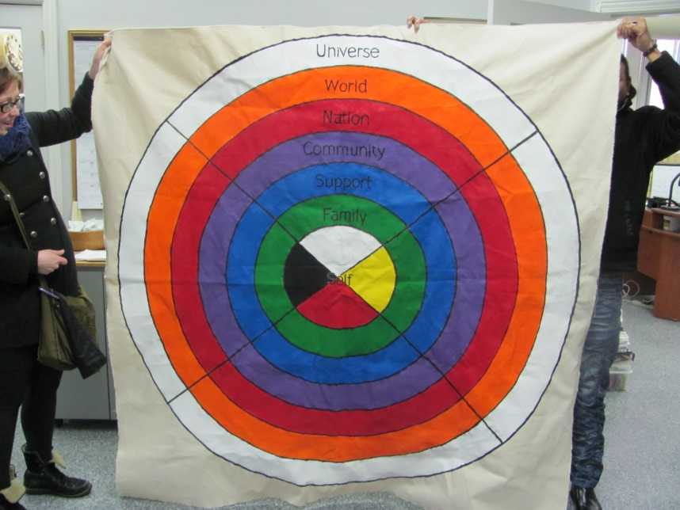
Developing the Research Tool

Slide 22
Focus Groups - Sharing Circles
Focus groups are sharing circles (Lavallee, 2009; Poff, 2006; Rothe et al, 2009)
Moderated by a two-spirit man living with HIV and a traditional helper
Use of traditional/ancestral knowledge (e.g. reflects oral culture)
Symbol-based inquiry (e.g., Ojibway medicine wheel used to stimulate dialogue about strengths, assets, resiliency)
3 sharing circles planned with a total of 14 participants involved
Ethical review (University of Toronto and McMaster University

Slide 23
Focus Group Query
What's allowing you to live well long-term with HIV?

Slide 24
Arranging Sharing Circles
Aboriginal team members were discouraged from contacting Circle moderators directly to avoid any concern of coercion of participants (who may already have a relationship with the circle moderator and the team members.
Local supports if participant gets triggered, personality clash potential as a barrier, etc.
No direct communication between Aboriginal research team members and identified Sharing Circle moderators/participants; in order to make sure the “list” of names was kept private and not accessible to anyone.

Slide 25
Recruitment of Participants
Recruitment proved challenging due to confidentiality, transportation, no familiar Aboriginal ‘touch’, no way to know who already signed on so Aboriginal team members could chase down potential participants being missed;
No direct way of Aboriginal research team members to know who was already contacted and who was being overlooked;
Some moderators expected Aboriginal research team members to be present at Sharing Circles;

Slide 26
Confidentiality
Academics were informed that Aboriginal team members knew who was speaking through the transcripts because we know our ‘family’ life stories, how they talk, what they typically talk about, and where the focus group happened;
Adding such things as Clans and names of places referred to within their stories to the list of identifiers;
Confidentiality challenged engaging Circle moderators, preparing sites, recruitment;

Slide 27
Coding of Transcripts
Non-Aboriginals sought direction on sections of transcripts which did not answer the questions being asked, rather espoused teachings and cultural knowledge;
Balancing research need to categorize while coding holistic world-views implied during focus groups;

Slide 28
Analysis and Angst
Line by line coding
Development of 5 meta themes
Reduced meta themes to the four quadrants of the medicine wheel
Selected the most meaningful/relevant codes from the meta themes by ranking them
Data were organized by code, printed and attached to foolscap which allowed for team to highlight and discuss most salient quotes for each code.
Notes:
Highlighted quotations were then mapped onto the medicine wheel. In analyzing the quotations, team members considered how the quotations fit onto and traversed the various components of the medicine wheel. This process involved reflecting on the content of the quotations, the relation of this content to our study question, and the relationships between various quotations. As in the highlighting of quotations, mapped quotations were reviewed and verified by a second team member.

Slide 32
Analysis and Angst
Using a participatory analysis approach (Flicker and Nixon, 2014), all team members then read transcripts and selected quotes they felt were relevant to answering the study question
Selected quotations were mapped onto the medicine wheel
Identification of relationships between codes
Notes:
Relationships were identified by identifying how codes related to one another, how they related to and across quadrants of the medicine wheel, and the intersections of these codes and their locations across the medicine wheel. Identification was inspired either by analyzing the meanings of codes and their relationships to the medicine wheel, or by specific quotations that were earmarked as highly pertinent to our study.

Slide 35
Analysis and Angst
These relationships were named and came to be recognized as the key components to understanding resilience among Two-Spirit HIV positive males.

Slide 36
Lessons Learned
Differing World Views, Perspectives, Priorities, and Requirements
The academics approached this research project according to what they believe to be proper and in accordance to the rules of formalized western institutes.
Aboriginal members hold our culture, tradition, knowledge and methodologies to be just as valid, if not more relevant to our people. In essence, we had to build our own vocabulary as we worked together. (e.g. Two-eyed seeing)

Slide 37
Lessons Learned
Ownership, Control, Access, and Possession
Easily achieved (used CAAN’s “Principles of Research Collaboration”)
Collaboratively designed the study
Methods (Sharing circles, medicine wheel, 7 sacred teachings)
Used participatory analysis
Agreement that community partners could do further, more specific research projects in the future

Slide 38
Lessons Learned
Consistent with the Indigenous methodologies, further use will acknowledge 2SHAWLS
Honours relationships, sources of knowledge, etc.
The data belong to the community as much as to the researcher
All administrative decisions were made by either 1) consensus of the team or 2) between the PI and the Principal knowledge user

Slide 39
Next Steps
Sharing the findings with you all …
The findings will be presented at a variety of venues: CAAN, AIDS 2014, OHTN conference, workshops, community forums, online, manuscripts

Slide 40
Community and Academic Future Research Plans
Involvement of local Aboriginal Ontario-based organizations to provide guidance and feedback
International Indigenous Working Group on HIV and AIDS
To strengthen the collaboration and partnership between international Indigenous communities and stakeholders in the fight against HIV and AIDS
International Indigenous Pre-Conference on HIV/AIDS to AIDS 2014 – Sydney , Australia
“Exploring the Health and Wellness of Long-Term HIV-positive Two-Spirit Men in Ontario”
Gage interest and possibly build international collaboration/partnership
Exploring funding opportunities for national/international work
United States, New Zealand, Australia, Peru, Chile

Slide 41
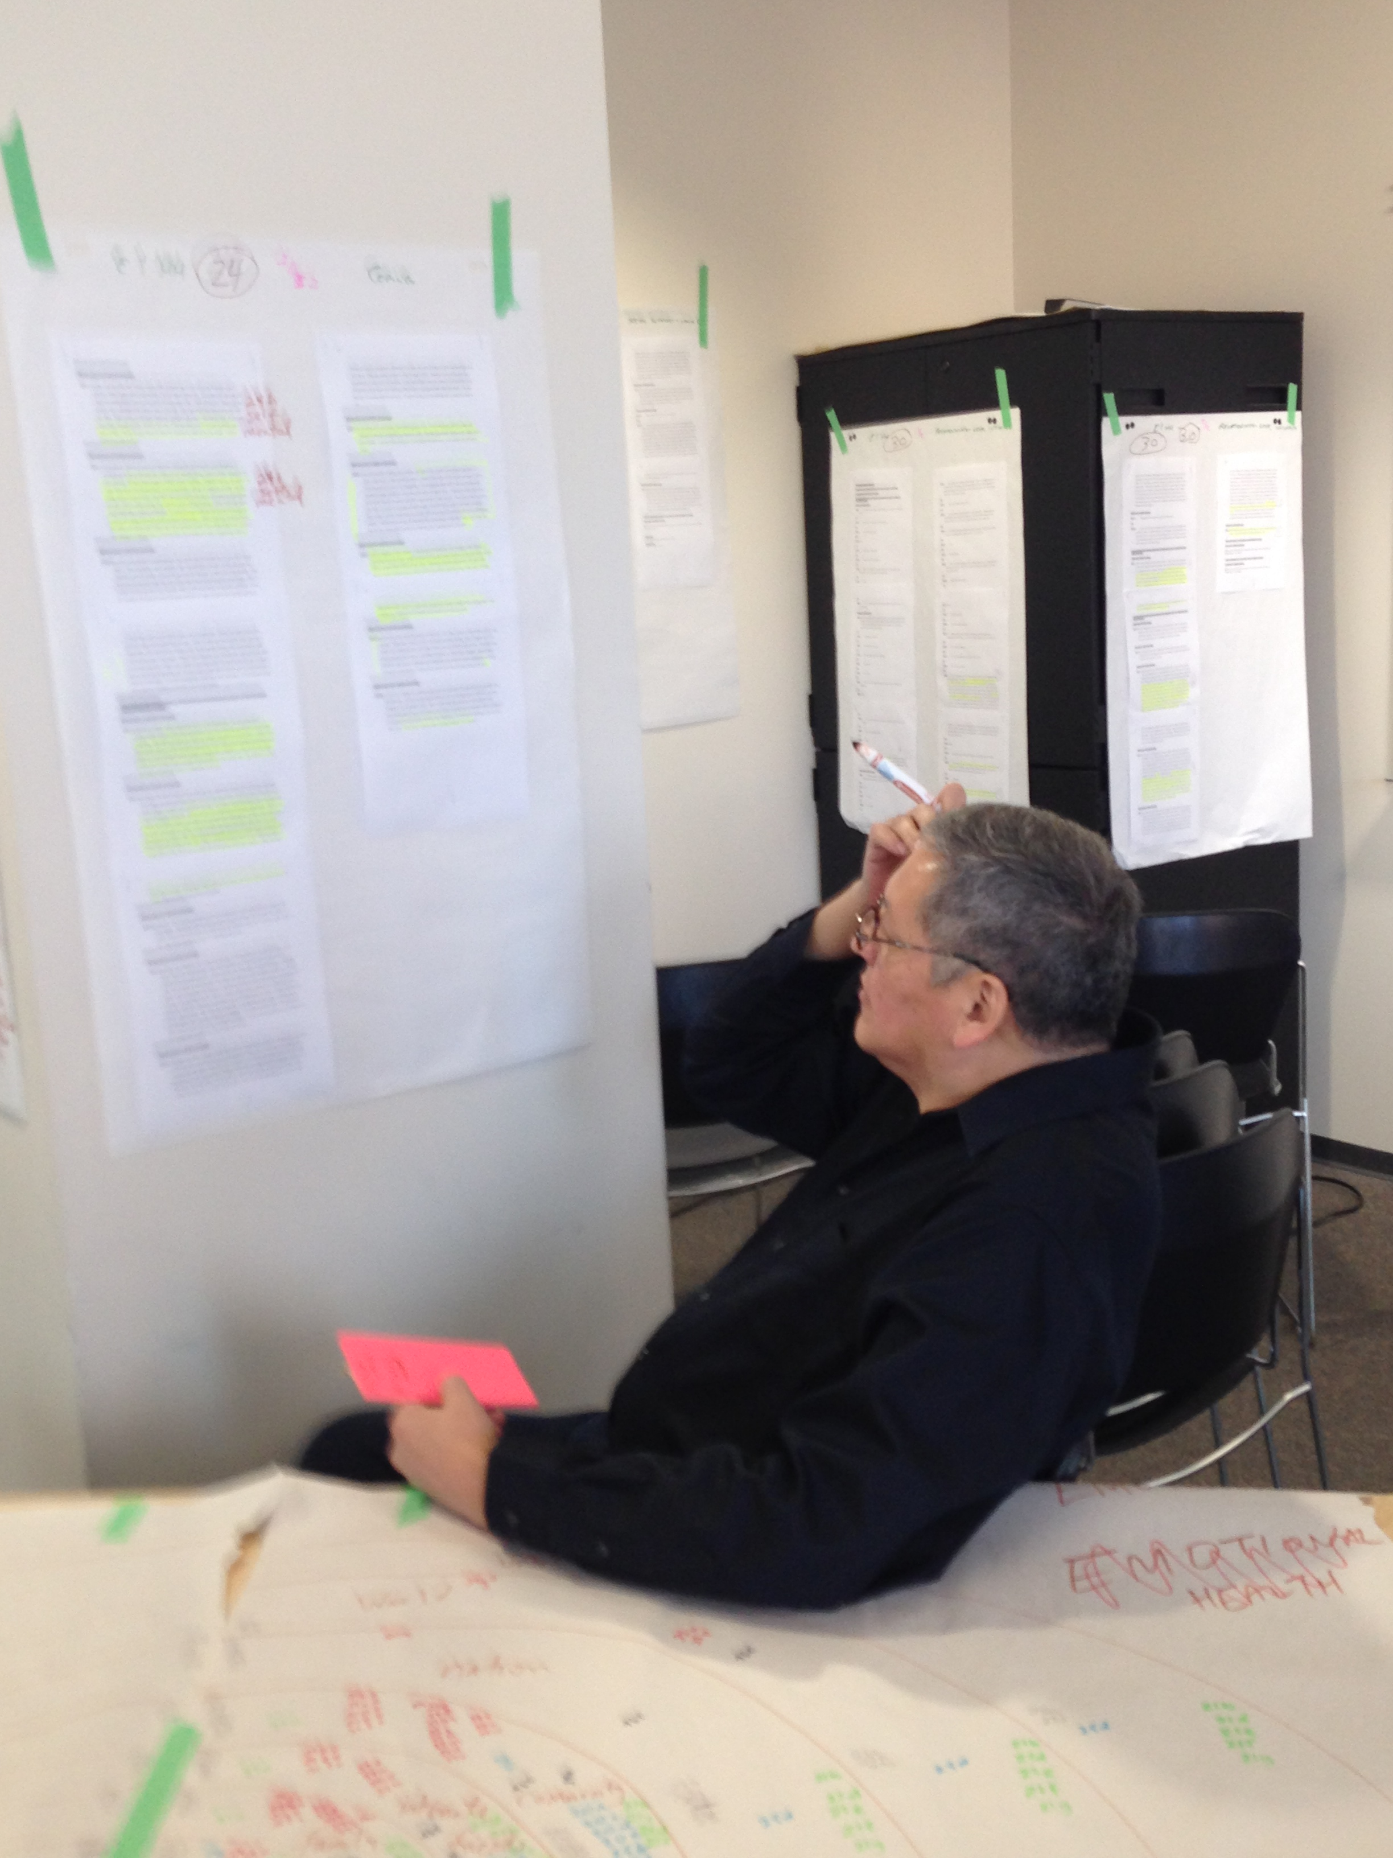
M E E G W E T C H !

